Slide 1
Oracle Database SQL Fundamentals
Internal Training
Toshiba Information Eqpt. (Phils.), Inc.
07.30.2019
Scope of Disclosure | within TIP only
Information Owner | TIP-Information Systems Department

Slide 2
Contents
01
Introduction to SQL
02
UNIT 1: Retrieving, Restricting, and Sorting Data
03
UNIT 2: Joins, Subqueries, and Set Operators
04
UNIT 3: DML and DDL

Slide 3
Introduction to SQL
01
TIP – Information Systems Department

Slide 4
Oracle Database SQL Fundamentals
Introduction to SQL
Data manipulation language (DML)
This manipulation involves inserting data into database
tables, retrieving existing data, deleting data from existing
tables and modifying existing data.
SELECT
INSERT
UPDATE
DELETE
CREATE
ALTER
DROP
RENAME
TRUNCATE
COMMENT
Data definition language (DDL)
A language used to define data structures and modify data.
For example, DDL commands can be used to add, remove,
or modify tables within in a database.
Data control language (DCL)
A syntax similar to a computer programming language
used to control access to data stored in a database
(Authorization).
GRANT
REVOKE
COMMIT
ROLLBACK
SAVEPOINT
Transaction control
Commands are used to manage transactions in the database.
These are used to manage the changes made to the data in
a table by DML statements.
TIP - Information Systems Department

Slide 5
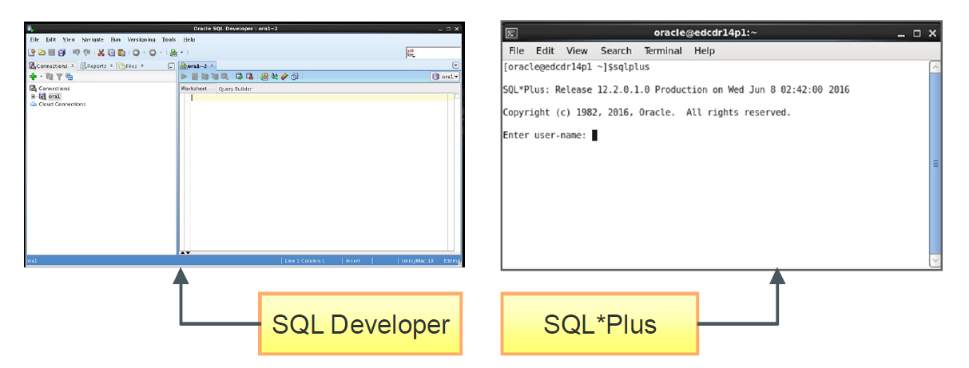
Oracle Database SQL Fundamentals
Development Environments for SQL
TIP - Information Systems Department

Slide 6
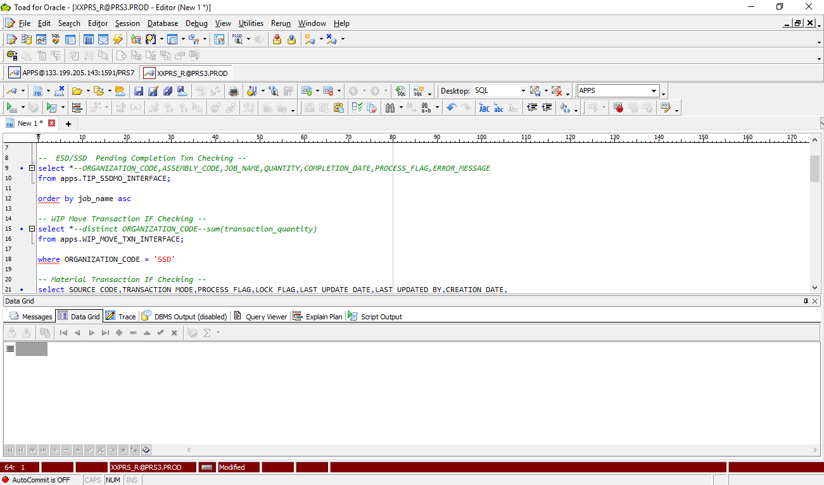

Oracle Database SQL Fundamentals
Toad Oracle Environment
TIP - Information Systems Department

Slide 7
Unit 1: Retrieving, Restricting, and Sorting Data
02
In this lesson, you will learn:
How to query the data from tables
How to query selected records from tables
How to sort the data retrieved from the tables
TIP – Information Systems Department

Slide 8
Oracle Database SQL Fundamentals
Workshop 1 – Retrieving Data Using SQL SELECT Statement
Selecting all data from different tables
Describing Structures of tables
Performing Arithmetic Calculations
SELECT DISTINCT | COLUMN NAME | COLUMN ALIAS | ARITHMETIC EXPRESSIONS | || {CONCAT} | LITERALS
FROM
TIP - Information Systems Department

Slide 9
Oracle Database SQL Fundamentals
Workshop 1 – Restricting and Sorting Data
Selecting data and changing the order of the rows
that are displayed
- Sorting rows by using WHERE, ORDER BY clause
SELECT DISTINCT | COLUMN NAME | COLUMN ALIAS | ARITHMETIC EXPRESSIONS | || {CONCAT} | LITERALS
FROM
WHERE
ORDER BY
TIP - Information Systems Department

Slide 10
Oracle Database SQL Fundamentals
Single ampersand substitution &
Double ampersand substitution &&
LOGICAL Operators
Operator | Meaning
= | Equal to
> | Greater than
>= | Greater than or equal to
< | Less than
<= | Less than or equal to
<> | Not equal to
BETWEEN ...AND... | Between two values (inclusive)
IN(set) | Match any of a list of values
LIKE | Match a character pattern
IS NULL | Is a null value
TIP - Information Systems Department

Slide 11
Oracle Database SQL Fundamentals
CHARACTER FUNCTIONS
Function | Result
LOWER('SQL Course') | sql course
UPPER('SQL Course') | SQL COURSE
INITCAP('SQL Course') | Sql Course
Function | Result
CONCAT('Hello', 'World') | HelloWorld
SUBSTR('HelloWorld',1,5) | Hello
LENGTH('HelloWorld') | 10
INSTR('HelloWorld', 'W') | 6
LPAD(salary,10,'*') | *****24000
RPAD(salary, 10, '*') | 24000*****
REPLACE ('JACK and JUE','J','BL') | BLACK and BLUE
TRIM('H' FROM 'HelloWorld')| LTRIM | RTRIM | elloWorld
TIP - Information Systems Department

Slide 12
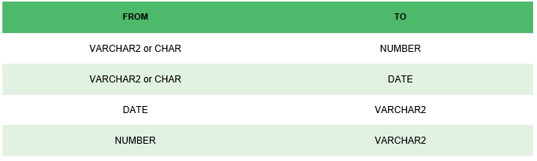
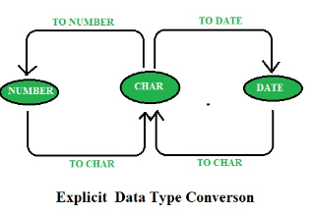
Oracle Database SQL Fundamentals
CONVERSION FUNCTIONS
Implicit Data-Type Conversion :
In this type of conversion the data is converted from one type to another implicitly
(by itself/automatically).
Explicit Data-Type Conversion :
TIP - Information Systems Department

Slide 13
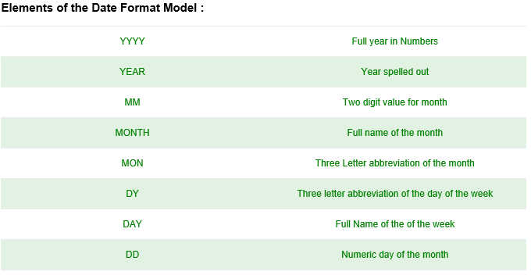
Oracle Database SQL Fundamentals
TO_CHAR FUNCTION with dates
The format model: Must be enclosed in single quotation marks and is case sensitive
Can include any valid date format element. Has an fm element to remove padded blanks or suppress
leading zeros. Is separated from the date value by a comma
SYNTAX: TO_CHAR(date, ’format_model’)
TIP - Information Systems Department

Slide 14
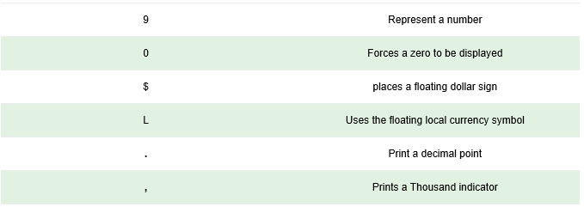
Oracle Database SQL Fundamentals
TO_CHAR FUNCTION with Numbers
SYNTAX: TO_CHAR(number, ’format_model’)
These are some of the format elements you can use
with the TO_CHAR function to display a number value
as a character :
TIP - Information Systems Department

Slide 15
Oracle Database SQL Fundamentals
GROUP FUNCTIONS
SUM
MAX
MIN
AVG
COUNT
SELECT DISTINCT | COLUMN NAME | COLUMN ALIAS | ARITHMETIC EXPRESSIONS | || {CONCAT} | LITERALS
FROM
WHERE
ORDER BY
GROUP BY
HAVING
TIP - Information Systems Department

Slide 16
Oracle Database SQL Fundamentals
MISCELLANEOUS FUNCTIONS
NVL - used to check null values. It returns expr2 if the expr1 is null, otherwise returns expr1
NVL2 - returns expr2 if expr1 is not null, otherwise return expr3.
CASE WHEN - evaluate a list of conditions and returns the related result expression
DECODE - compares an expr with search value one by one. If the expr does not match
any of the search value then returns the default value.
If the default value is omitted then returns null
TIP - Information Systems Department
Notes:
select first_name, nvl(commission_pct,'0')
from employees;
==========================
select first_name, nvl2(commission_pct, salary+commission_pct, salary)
from employees;
=========================
select first_name, salary,
case when salary > 20000 THEN 'Over 20K'
WHEN salary > 19999 AND salary <= 20000 THEN 'Under 20K'
ELSE '10K is or under'
END as Income
FROM employees;
=======================

Slide 17
Unit 2: Joins, Subqueries, and Set Operators
03
In this lesson, you will learn:
SQL Statements to query and display data from tables by using joins
Subqueries when condition is unknown
Group functions to aggregate data.
Set Operators
TIP – Information Systems Department

Slide 18
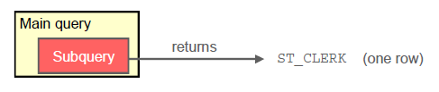

SQL WORKSHOP
SUBQUERY SYNTAX
Single Row Subquery
- Queries that return only one row from the inner SELECT statement
Multiple Row Subquery
-Queries that return more than one row from the inner SELECT
SELECT select_list
FROM table
WHERE expr operator
(SELECT select_list
FROM table);

Slide 19
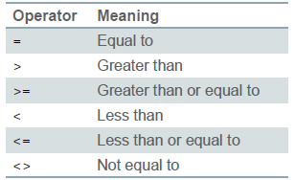


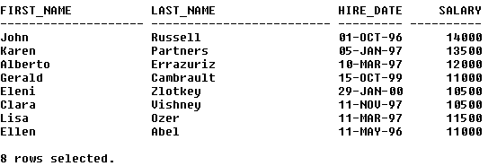
SQL WORKSHOP
Single Row Subquery

Slide 20
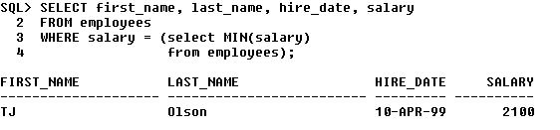

SQL WORKSHOP
Using GROUP functions in subqueries
Using HAVING clause with subqueries

Slide 21
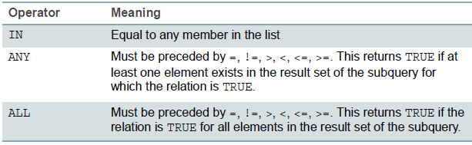


SQL WORKSHOP
Multiple Row Subquery
Return more than one row
Use multiple-row comparison operators
Notes:
IN
SELECT first_name, last_name, hire_date, sa
FROM employees
WHERE salary IN (select AVG(salary)
from employees
group by job_id)
===========================
ANY
select first_name, last_name, salary, job_id, hire_date
from employees
where salary < ANY
(select salary
from employees
where job_id = 'SA_REP')
AND job_id != 'SA_REP'
=============================

Slide 22
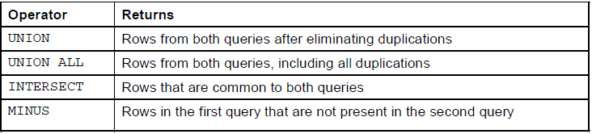
SQL WORKSHOP
USING SET OPERATORS
Combine the results of two or more component queries into one result
Queries containing set operators are called ‘compound queries’
Notes:
IN
SELECT first_name, last_name, hire_date, sa
FROM employees
WHERE salary IN (select AVG(salary)
from employees
group by job_id)
===========================
ANY
select first_name, last_name, salary, job_id, hire_date
from employees
where salary < ANY
(select salary
from employees
where job_id = 'SA_REP')
AND job_id != 'SA_REP'
=============================
select first_name, last_name, manager_id
from employees
where manager_id =ANY (select manager_id
from employees)

Slide 23
Unit 3: DML and DDL
04
In this lesson, you will learn:
How to manage data in table using data manipulation language statements
To create and manage database objects using data definition language statements.
TIP – Information Systems Department

Slide 24
SQL WORKSHOP
DML – Data Manipulation Language
The SQL commands that deals with the manipulation of data present in database belong to DML or Data Manipulation Language and this includes most of the SQL statements.
INSERT
SYNTAX: INSERT INTO table [(column [, column...])]
VALUES (value [, value...]);
UPDATE
SYNTAX: UPDATE table
SET column = value [, column = value, ...]
[WHERE condition];
DELETE
SYNTAX: DELETE [FROM] table
[WHERE condition];

Slide 25
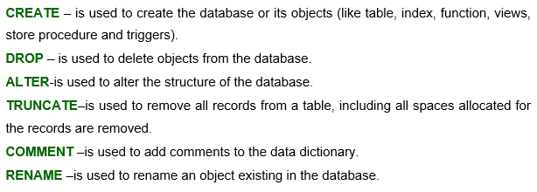
SQL WORKSHOP
DDL – Data Definition Language
DDL or Data Definition Language actually consists of the SQL commands that can be used to define the database schema. It simply deals with descriptions of the database schema and is used to create and modify the structure of database objects in database.

Slide 26

SQL WORKSHOP
DATA CONTROL LANGUAGE
DCL includes commands such as GRANT and REVOKE which mainly deals with the rights, permissions and other controls of the database system

Slide 27
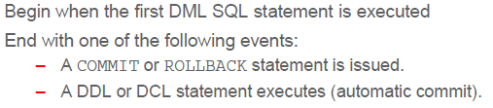
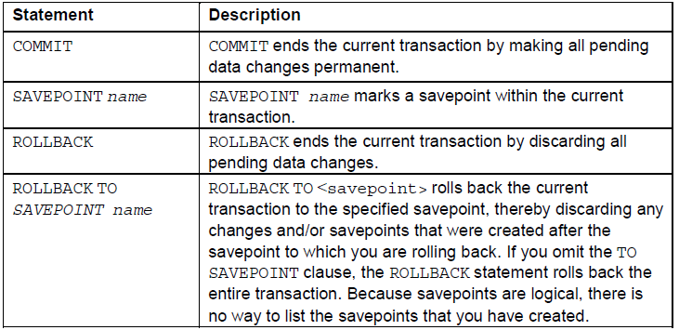
SQL WORKSHOP
TRANSACTION CONTROL LANGUAGE

Slide 28

Oracle Database SQL Fundamentals
Questions?
TIP - Information Systems Department

